Slide 1
CASTPONE PROJECT - 1
INTRODUCTION

Slide 2
HEART DISEASE DETECTION

Slide 3
OBJECTIVE:
BUILD THE MODEL WHICH CAN DETECT THE HEART DISEASE IN PATIENT IN GIVEN RANGE OF PROBLEM STATEMENT.
USE OF DIFFERENT MEACHINE LEARNING ALGORITHMS TO DETERMINE WHICH IS BEST FIT TO DETECT THE DISEASE.
DETERMINE USE OF DATA SCIENCE IN MEDICAL INDUSTRY AND GO IN DEEP ABOUT ITS CONCEPTS.
TRY TO HANDLE THE DATA CAREFULLY , UNDERSTAND ABOUT DATA INTERPRETATION AND ENHANCE OUR ABILITY FOR FUTURE WORK.

Slide 4
WHY I CHOOSE THIS PROJECT?
IN DATA SCIENCE SOMETIMES CATEGORICAL DATA IS NOT EASY TO HANDLE BECAUSE EVEN THOUGH ALL VALUES IN NUMBERS THEY REPRESENT DIFFERENT VALUES WHICH IS BELONG TO DIFFERENT CATEGORIES THAT’T WHY IT IS DIFFICULT TO PREDICT WHICH NUMBER IS BELONG TO WHICH CATEGORY OR VALUE.
AS WE ALL KNOW ANY INDUSTRY CONTAINS LOTS OF RECORDED DATA REGARDING THEIR PAST PROGESS , CURRENT PROGESS ON WHICH THEY PLAN FOR THEIR FUTURE OR TRY DIFFERENT TECHNIQUES TO ENHANCE THEIR PRFORMANCE.
LIKE ANOTHER INDUSTRY MEDICAL INDUSTRY ALSO TRY TO RECOGNIZE AND TRY THEIR BEST TO CURE AND DISEASE BEFORE THEY GET WORSEN SO THEY USING DATA SCIENCE FOR THEIR EFFORTS TO CURE PEOPLE FROM ANY DANGEROUS DISEASE.
HEART DISEASE IS ONE OF THE BIGGEST PROBLEM FOR HUMAN HEALTH THAT’S WHY PREDICTING IT BEFORE IT GETTING WORSE IS THE BEST WAY TO SAVE A LIFE.

Slide 5
WHY I CHOOSE THIS PROJECT?
ALSO IN MEDICAL FIELD HANDLING OF DATA RELATED TO PATIENT IS QUIET DIFFICULT AS IT CONTAINS LOTS OF RECORDS REGRADING PAST HISTORY , CURRENT AFFAIRS AND ALSO ON GOING REVOLUTION IN DATA HANDLING AND MANAGING.
ALSO THOSE WHO DOESN’T AFFECTED BY AND DISEASE MANAGING AND KEEPING ON THEIR PROGRESS IS NOT SO EASY.
THE DATA I GOT IS QUITE DIFFICULT TO HANDLE AND ALSO IT CONTAINS LOTS OF CHALLENGES BY WHICH I CAN LEARN MORE ABOUT DATA OPERATIONS AND ITS MANAGING ON DIFFERENT SCALE.

Slide 6
GOAL SETTING OF THE PROJECT:
LEARN MORE ABOUT CATEGORICAL VALUES AND ITS COMPATIBILITY WITH ML ALGORITHMS.
COMPLETELY UNDERSTAND THE DATA BY DOING PRIMARY ANALYSIS.
LEARN ABOUT DIFFERENT ML ALGORITHMS AND ITS ABILITY TO HANDLE THE DATA
IMPLEMENTING THE OPERATIONS WHICH CAN OVERCOME THE EFFECT OF CLASS IMBALANCE AND ITS USE IN MODEL BUILDING.
UNDERSTAND ABOUT ENSEMBLE METHOD WORKING AND ITS APPLICATION IN MODEL BUILDING.
AND BUILD THE MODEL WHICH CAN CATCH THE HEART DISEASE PATIENT WITH HIGH ACCURACY.

Slide 7
PLANNING ON PROJECT:
DATASET I GOT IS COMPLETELY RELATED CATEGORICAL SENSE THAT’S WHY THAT MUCH CLEANING AND PROCESSING ON DATA IS NOT MUCH NEEDED.
FIRSTLY I UNDERSTAND THE DATA FROM START THAT MEANS HOW MANY RECORDS IT CONTAINS , HOW MANY COLUMNS IT HAS ALSO IS THEIR ANY CLASS IMBALANCE IN THE DATA OR NOT AND IT HAS ANY MISSING VALUES.
THEN I DONE EDA ANALYSIS ON THE DATA TO UNDERSTAND IT PROPERLY.
THEN ACCORDING TO PROBLEM STATEMENT SELCTION OF RANGE IS DONE AND DELETING OF OTHER RECORDS PROCEED.

Slide 8
PLANNING ON PROJECT:
THEN MAIN MODEL BUILDING IS STARTED, I USE DIFFERENT ML ALGORITHMS TO FIND OUT WHICH ONE IS GOOD IN DETECTING THE DISEASE.
DIFFERENT OPERATIONS ARE DONE TO ENHANCE THE PERFORMANCE OF THE ALGORITHMS FOR BETTER RESULT.
THEN ENSEMBLE METHOD IS DONE FOR BETTER AND BEST MODEL GET SELECTED.

Slide 9
PROCEDURE ON THE DATA FOR MODEL BUILDING:
UNDERSTANDING THE DATA PROPERLY.
SELECTION OF RANGE AS PER PROBLEM STATEMENT.
EDA ANALYSIS
CHECKING FOR OUTLIERS.
MODEL BUILDING USING LOGISTIC REGRESSION , DECISION TREE , RANDOM FOREST , K-NEAREST NEIGHBOUR , SUPPORT VECTOR MACHINE.
CHECKING FOR CLASS IMBALANCE AND IF IT IS THEIR DO DIFFERENT OPERATIONS FOR REMOVING ITS EFFECT ON RESULTS.
DELIVER CONCLUSION AND CHOOSE BEST MODEL FOR PREDICTION.

Slide 10
MAIN PART
PROJECT EXECUTION
[BODY]

Slide 11
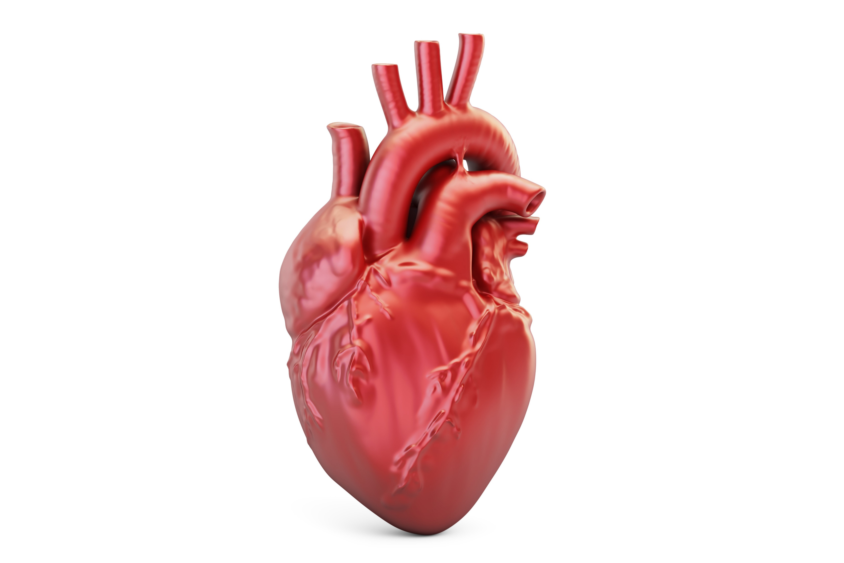
PROBLEM STATEMENT:
BUILD A MODEL WHICH CAN DETECT THE HEART DISEASE PATIENT FROM WORLDWIDE BMI ACCEPTED RANGE FOR NORMAL AND PRE-OBESSED CLASS. I.E; 18.5 TO 29.9.

Slide 12
ABOUT DATASET:
FOR UNDERSTANDING THE PROBLEM STATEMENT WE MUST UNDERSTAND THE DATASET.
THE DATASET IS RELATED TO RECORDS OF HEART DISEASE PATIENTS WHICH IS FROM YEAR 2021 REGARDING THEIR HEALTH ISSUES AFTER THE LOCKDOWN OF 2020.
THE DATSET HAS TOTAL OF 315796 RECORDS FROM WHICH AFTER UNDERSTANDING THE PROBLEM STATEMENT A PATICULAR RANGE OF RECORD MUST BE USED.
AFTER SELECTING BMI RANGE RECORDS AS PER GIVEN IN PROBLEM STATEMENT THE DATASET IS LEFT WITH 211748 RECORDS.
AS PER PRIMARY LOOK THE DATSET CONTAINS A HUGE CLASS IMBALANCE WHICH NEED TO BE REMOVED.

Slide 13
ABOUT DATASET:
THE DATSET CONTAINS TOTAL OF 18 COLUMNS RELATED OTHER HEALTH PROBLEMS , SEX , AGE CATEGORY , AND RACE OF THE PATIENTS.
THE DATA IS PURELY NUMERIC WITH NO MISSING VALUES.
OUR TARGET VARIABLE IS HEART DISEASE ON WHICH WE HAVE TO BUILD A MODEL FOR PREDICTING A HEART DISEASE PATIENTS.

Slide 14
DATASET ATTRIBUTES:
THE DATASET HAS TOTAL OF 18 COLUMNS WHICH ARE AS FOLLOWING:
HEART DISEASE:TARGET VARIABLE IT INDICATED WHETHER PATIENT HAS HEART DISEASE OR NOT.
BMI : BODY MASS INDEX
SMOKING : SHOWS PATIENT IS SMOKER OR NOT.
ALCOHOL DRINKING : IT CONTAINS WHETHER THE PATIENT IS ALCOHOLIC OR NOT.
STROKE : IT CONTAINS PATIENT HAS A STROKE OR NOT.
PHYSICAL HEALTH : THIS COLUMN CONTAINS 31 DIFFERENT VALUES WHICH CAN DENOTE DIFFERENT STAGES OF PHYSICAL HEALTH OF THE PATIENT.

Slide 15
DATA ATTRIBUTES:
MENTAL HEALTH : THIS ALSO CONTAINS 31 DIFFERENT VALUES WHICH DENOTE DIFFERENT STAGES OF MENTAL HEALTH OF TRHE PATIENT.
DIFFICULTY IN WALKING : IT DENOTES WHETHER PATIENT HAS DIFFCULTY IN WALKING OR NOT.
SEX : GENDER OF THE PATIENT.
AGE CATEGORY : IT CONTAINS ACCORDING TO AGE PATIENT IN WHICH CLASS.
RACE : IT SHOWS PATIENT IS BELONG TO WHICH RACE I.E; WHETHER IT IS BLACK , WHITE ETC.
DIABETIC : THIS COLUMN SHOWS PATIENT IS DIABETIC OR NOT.
PHYSICAL ACTIVITY : THIS COLUMN CONTAINS PATIENT NORMAL ACTIVITY IN DAILY LIFE MEANS PATIENT IS ACTIVE OR JUST SETTING IN ONE PLACE.
GENRAL HEALTH : IT SHOWS DIFFERNT STAGES OF GENRAL HEALTH OF PATIENT.
SLEEP TIME : THIS COLUMN SHOWS HOW MANY HOURS PATIENT GET THE SLEEP EVERYDAY.

Slide 16
DATA ATTRIBUTES:
ASTHMA : THIS COLUMN CONTAINS PATIENT HAS ASTHMA OR NOT.
KIDNEY DISEASE : THIS COLUMN SHOWS KIDNEY DISEASE INFORMATION OF PATIENT.
SKIN CANCER : THIS COLUMN SHOWS WHETHER PATIENT IS SUFFERING FROM SKIN CANCER OR NOT.

Slide 17
SELECTION OF RANGE:
AS PER THE PROBLEM STATEMENT FOR BUILDING A MODEL A WORLDWIDE ACCEPTED RANGE SHOULD BE SELECTED.
FOR NORMAL AND PRE-OBSSESS CLASS WORLD-WIDE ACCEPTED RANGE IS 18.5 TO 29.9.
IN DATASET THE BMI RANGES FROM 12 TO 94.5 SO I HAVE TO DELETE OTHER RECORDS WITH SLECTING ONLY NORMAL CLASS AND PRE-OBSSESS CLASS RANGE.
AFTER DELETING THOSE RECORDS I LEFT WITH ONLY SELECTED RANGE RECORDS.
THE DATASET NOW CONTAINS TOTAL OF 211748 RECORDS WHICH INCLUDE BOTH PATIENTS OF HEART DISEASE I.E; YES OR NO.
DURING MODEL BUILDING I HAVE TO DO SOME OPERATIONS DUE TO WHICH RECORDS GET REDUCED TO 40451 RECORDS.

Slide 18
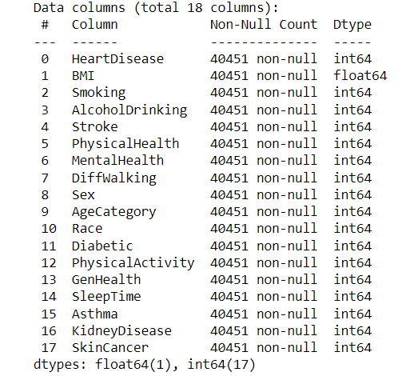
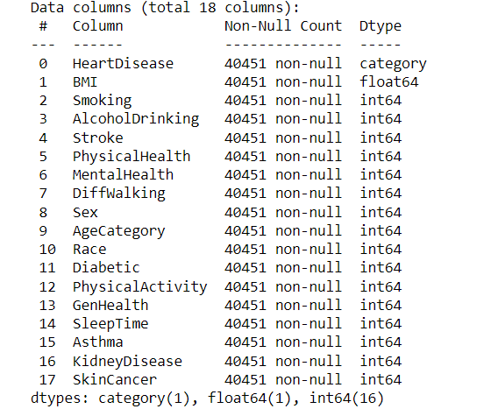
EDA ANALYSIS:
FOR UNDERSTANDING THE DATA WE MUST ANALYSED IT IN A PROPER WAY.
THAT’S WHY EXPLORATORY DATA ANALYSIS IS DONE FOR PROPER UNDERSTANDING OF DATA.
FIRST WE GET THE DATA INFORMATION WHICH COLUMN IN WHICH FORM.
THEN CONVERTING TARGET VARIABLE IN CATEGORY FORM FOR FURTHER DATA PROCESSING.

Slide 19
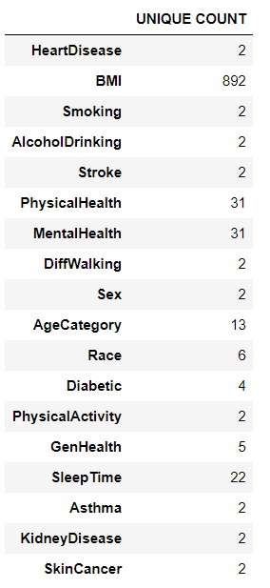
EDA ANALYSIS:
THEN DETERMINING OF UNIQUE COUNT OF EACH COLUMN. MEANS EX. HEART DISEASE HAS ONLY 2 VALUES THAT IS YES OR NO MEANS IT HAS ONLY 2 UNIOUE COUNT.

Slide 20
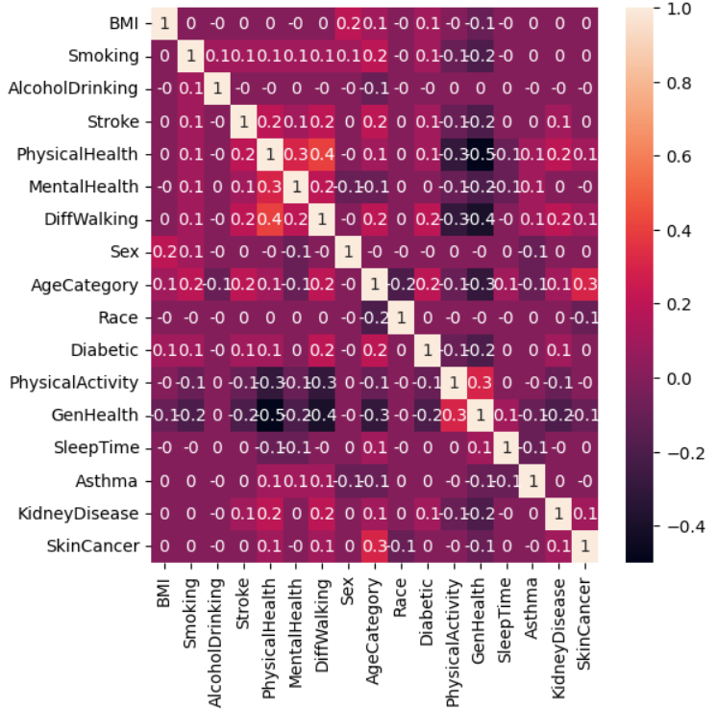
EDA ANALYSIS:
THEN CHECKING THE DATASET FOR MULTI-COLLINEARITY. MEANS CHECKING WHETHER COLUMNS ARE HIGHLY CONNECTED WITH EACH OTHER OR NOT. CHECKING ITS CO-RELATION. FROM OBSERVATION IT SEEN THAT THEY ARE NOT CO-RELATED.
HEATMAP OF HEART DISEASE DATASET

Slide 21
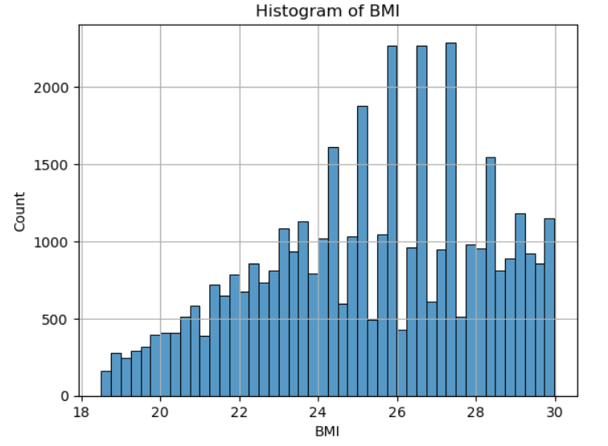
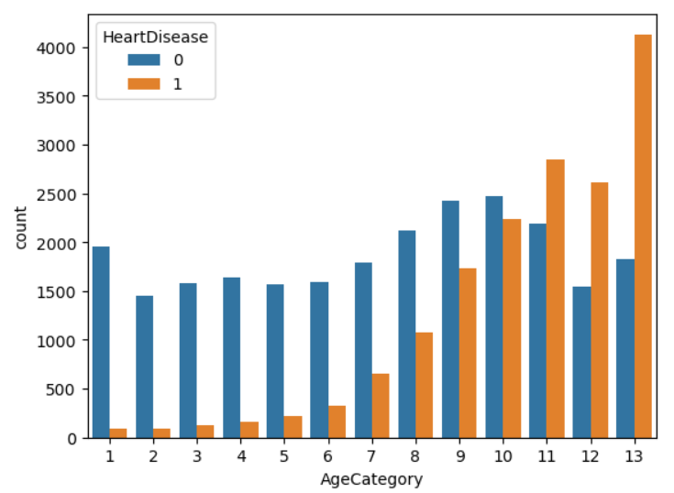
EDA ANALYSIS:
AS PER THE SELECTED RANGE SO THERE IS NO PROBLEM OF OUTLIERS.
THEN CHECKING OF BMI RECORDS USING HISTOGRAM AND HEART DISEASE RECORDS IN AGE CATEGORY USING BAR GRAPH.
A)HISTOGRAM OF BMI
B)HEART DISEASE IN AGE CATEGORY

Slide 22
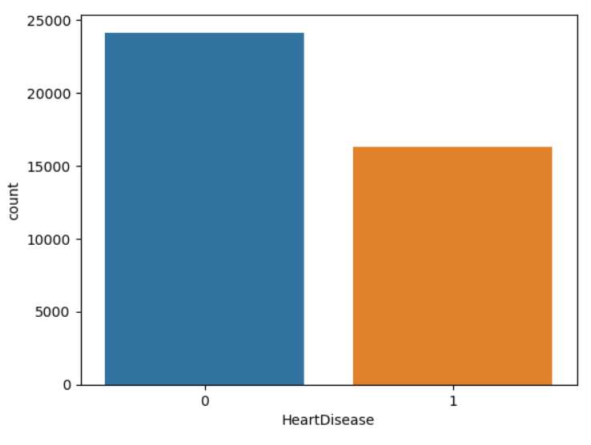
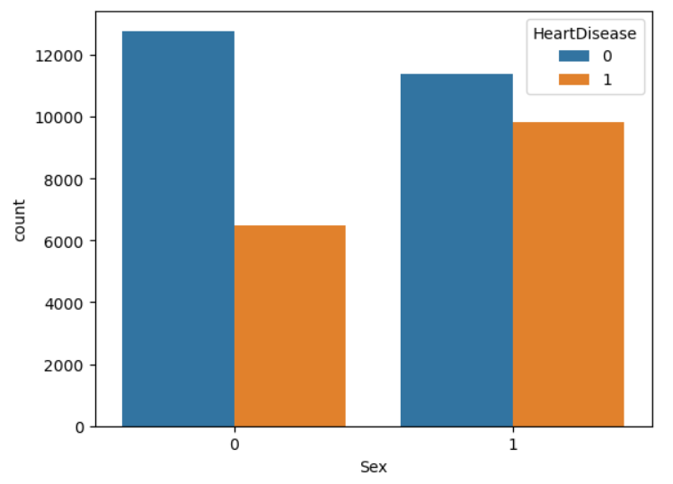
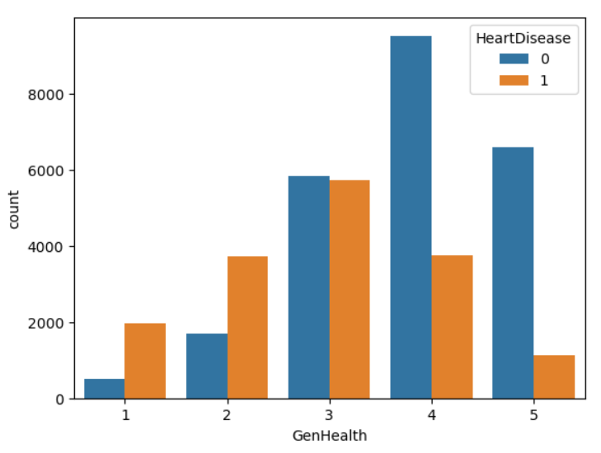
EDA ANALYSIS:
THEN HEART DISEASE RECORDS GET CHECKED WITH THAT ON SEX AND GENRAL HEALTH BASIS HEART DISEASE RECORD GET CHECKED.
B)HEART DISEASE COUNT IN GENDER
A)HEART DISEASE COUNT
C)HEART DISEASE IN GENRAL HEALTH CATEGORY

Slide 23
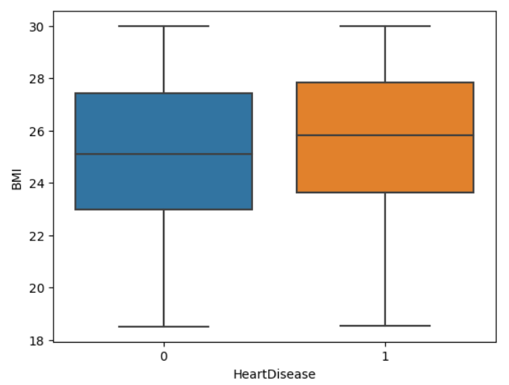
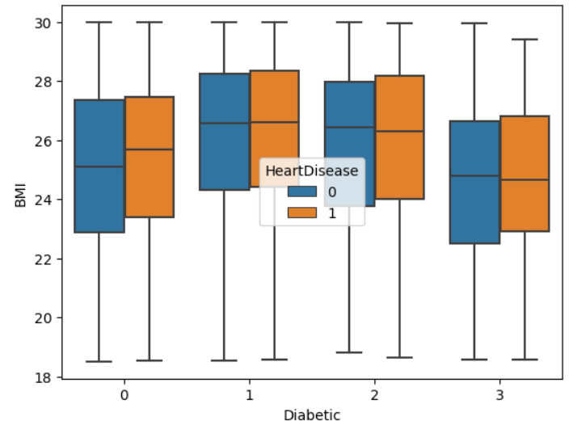
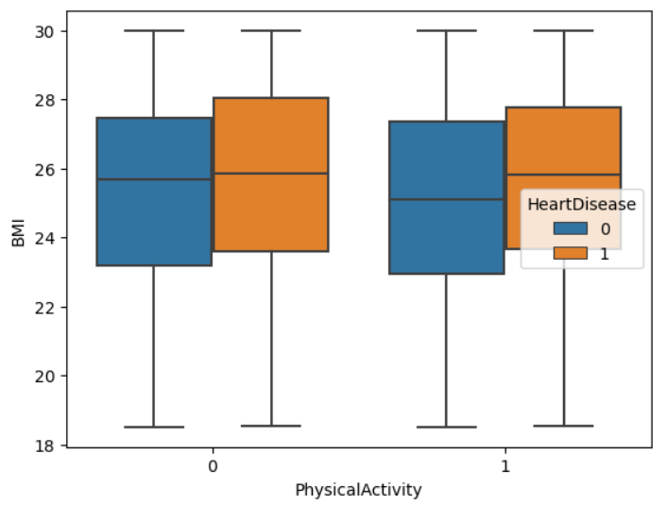
EDA ANALYSIS:
THEN I ANALYSE THE OTHER COLUMNS ON BMI BASIS. MEANS THOSE FACTORS WHICH CAN AFFECT HEART DISEASE I ANALYSE THEM USING BOX PLOT.
A)HEART DISEASE VS BMI
B)BMI VS DIABETIC
C)BMI VS PHYSICAL ACTIVITY

Slide 24
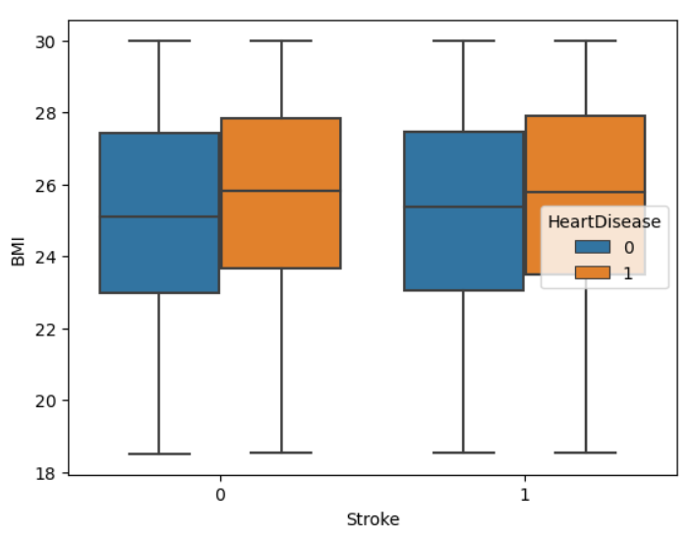
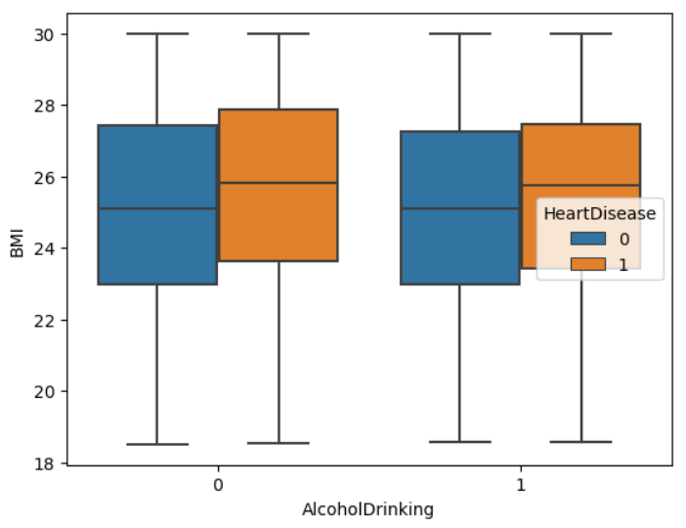
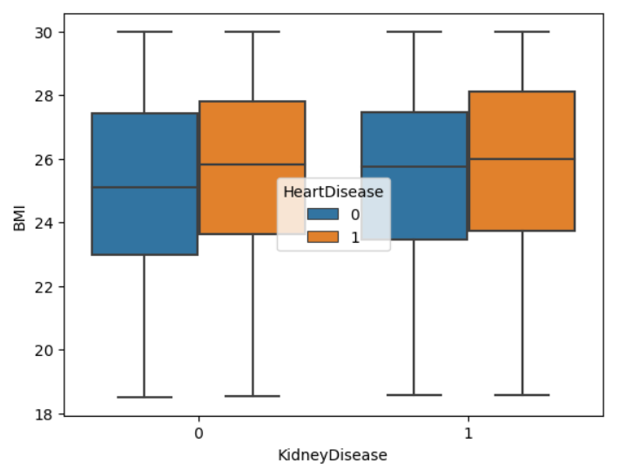
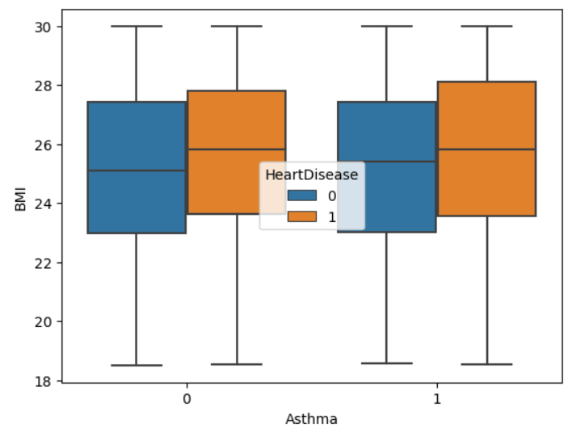
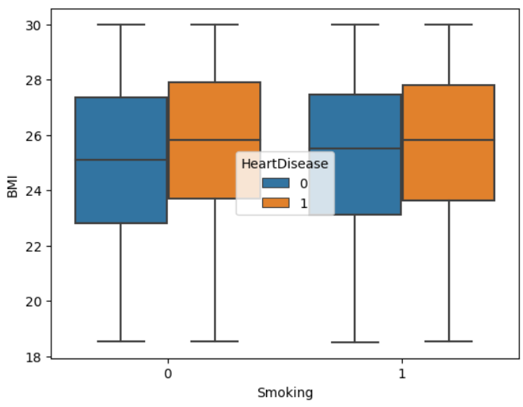
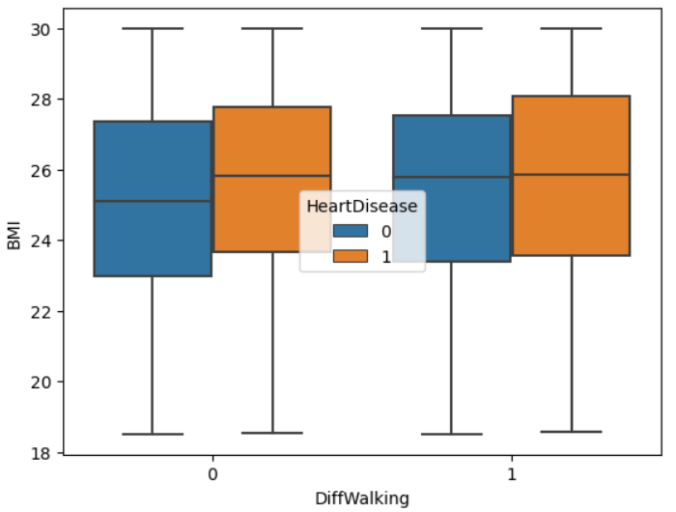
EDA ANALYSIS:
D) BMI VS STROKE
E)BMI VS ALCOHOL DRINKING
F)BMI VS KIDNEY DISEASE
G)BMI VS STROKE
H)BMI VS SMOKING
I)BMI VS DIFFICULTY IN WALKING

Slide 25
MODEL BULIDING:
AS DATASET IS COMPLETELY CATEGORICAL I USED MACHINE LEARNING ALGORITHMS WHICH CAN WORK WITH CATEGORICAL DATA.
THE ALGORITHMS WHICH CAN WORK WITH CATEGORICAL DATA ARE LOGISTIC REGRESSION , DECISION TREE , RANDOM FOREST , K-NEAREST NEIGHBOUR , SUPPORT VECTOR MACHINE AND ENSEMBLE TECHNIQUE.
FIRST I STARTED WITH LOGISTIC THEN DECISION TREE AFTER THAT I APPLY ALL THE ALGORITHMS WHICH CAN HANDLE CATEGORICAL DATA.
BUT FROM OBSERVATION I GET TO KNOW THAT MODELS STILL NOT GIVING BETTER RESULT AS PER THE TARGET.
SO I HAVE USE CONCEPT OF UNDERSAMPLING AND OVERSAMPLING FOR BETTER RESULT AND IN CLASSIFICARTION ALGORITHMS I USED HYPER-PARAMETER TUNING FOR EQULVALENT PERFORMANCE OF MODEL.
DURING THIS OPERATIONS DATASET RECORDS GET REDUCED FROM 211748 TO 40451.

Slide 26
MODEL BUILDING:
AS ALL ALGORITHMS NOT GIVING THE GOOD RESULT MEANS DATASET DEFINITELY HAS CLASS IMBALANCE.
ALSO DATASET IS DIVIDED IN TRAIN-TETS FORMAT AS PER WORLDWIDE STANDARD I.E; 80:20 CRITERIA.
CLASS IMBALANCE MEANS REPRESENTATION OF ONE CLASS IS MORE THAN OTHER CLASS.
SO TO SOLVE THIS ISSUE I USED THE CONCEPT UNDERSAMPLING AND OVERSAMPLING.
FIRST I GO WITH OVERSAMPLING MEANS INCREASING THE RECORD OF LOWER REPRSENTED CLASS.
BUT STILL I DIDN’T GET PROPER RESULT FROM THAT AS ACCURACY IS STILL BELOW 60% SO LASTLY I GO FOR ANOTHER OPTION I.E; UNDERSAMPLING.
UNDERSAMPLING MEANS DECREASING THE RECORD OF UPPER REPRESENTED CLASS.

Slide 27
MODEL BUILDING:
I STARTED TO DELETE RANDOM RECORDS FROM DATASET STEPWISELY.
I DELETED THE RECORDS TILL THE I GETTING THE PROPER RESULT FROM ALGORITHMS.
I DELETED TOTAL OF 171297 RECORDS UNTIL THE PROPER RESULT IS NOT ACHIEVED.
IN DECISION TREE AND RANDOM FOREST I HAVE DONE THE HYPER-PARAMETER TUNING FOR BETTER RESULT.
MEANS I ADDED A HYPER-PARAMETER OF CLASS WEIGHT AS BALANCED FOR ENHANCING THE PERFORMANCE.
IN K-NEAREST NEIGHBOUR SAME CONCEPT OF UNDERSAMPLING IS IMPLEMENTED WITH K-NEIGHBOURS VALUE FIXING AT 6.
IN SUPPORT VECTOR MACHINE WITH THE CONCEPT OF UNDERSAMPLING I USED THE POLYNOMIAL KERNEL WITH DREGREE 2.

Slide 28

MODEL BUILDING:
THEN I USED ENSEMBLE METHOD.
ENSEMBLE IS TECHNIQUE WHICH CAN GATHER RESULT OF WEAK LEARNERS I.E; GATHER RESULT OF MULTIPLE ML ALGORITHMS TO OBTAIN BETTER RESULT FOR PREDICTIVE PURPOSE.
IN ENSEMBLE I USED ADA BOOST CLASSIFIER , XG-BOOST AND GRADIENT BOOSTING CLASSIFIER TO FIND PROPER ACCURACY OF THE MODEL.

Slide 29
TOOLS AND PLATFORM:
THIS PROJECT IS COMPLTELY RUN ON EXCEL , JUPYTER NOTEBOOK RELATED TO PYTHON PROGRAMMING LANGUAGE.
FOR EDA ANALYSIS I USED MATPLOTLIB AND SEABORN LIBRARY.
FOR MODEL BUILDING AND FOR PROPER RESULT I USED PANDAS, NUMPY, ML LIBRARY RELATED TO LOGISTIC, DECISION TREE , RANDOM FOREST , K-NEAREST NEIGHBOUR , SUPPORT VECTOR MACHINE AND LIBRARY RELATED TO ENSEMBLE TECHNIQUE.
ALSO DATA VISUALIZATION TOOLS LIKE TABLEAU IS ALSO USED FOR SHORT ANALYSIS MEANS WHAT I HAVE DONE PROJECT.
AND M.S. POWER POINT FOR DETAILING OF MY PROJECT AND CONVERTING IT INTO PRESENTATION FORMAT.
AS IT IS RUN ON JUPYTER NOTEBOOK ANACONDA PROMPT AS A PLATFORM IS USED.

Slide 30
CHALLENGES:
I FACED THREE BIGGEST CHALLENGES IN THE PROJECT:
FIRST HANDLING OF THE DATA- AS FIRSTLY THESE DATASET CONTAIN TOTAL 3 LAKH RECORD SO ANALYSING IT THAT TIME IS QUITE DIFFICULT. AFTER THAT DELETING EXTRA RECORDS STEPWISE IS QUITE TIME-CONSUMING.
CLASS IMBALANCE-THIS ANOTHER HUGE PROBLEM I FACED DURING PROJECT.AS RECORDS WITH NO HEART DISEASE ARE FAR GREAT NUMBER THAN YES IN HEART DISEASE. SO DURING UNDERSAMPLING I HAVE TO DELETE RECORDS SLOWLY AND IN LIMLTED AMOUNT FOR NOT HAMPERING THE ML ALGORITHMS OPERATIONS. DELETING THESE RANDOM RECORDS IS TIME CONSUMING. AND THEN AGAIN RANDOMIZING THE RECORDS IN EXCEL FOR AVOIDING SEQUENTIALITY.
INSIGNIFICANT VARIABLE-IN DATASET SOME INSIGNIFICANT VARIABLES ARE THERE WHICH HAMPERING THE RESULT. I HAVE TO DROP THAT DURING MODEL-BUILDING BUT HOW MANY COLUMNS OR VARIABLE ARE THERE I HAVE TO DETERMINE THAT.

Slide 31

SOLUTION ON CHALLENGES:
USING PROPER COMMANDS AND TOOLS I HANDLE THE DATA IN EXCEL.
I SOLVE THE CLASS IMBALANCE PROBLEM USING UNDERSAMPLING AND HYPER-PARAMETER TUNING CONCEPTS WHICH ARE BEST FITTED FOR MODEL PERFORMANCE.
USING CORRLEATION AND HEATMAP I DETERMINE WHICH VARIABLE IS GIVING NEGLIGIBLE RESULT AGAINST TARGET VARIABLE SO I DROP THAT VARIABLE DURING MODEL BUILDING.

Slide 32
ADVANTAGES:
AS WE ALL KNOW MACHINE LEARNING HAS HUGE IMPACT ON DIFFERENT FIELDS AND MEDICAL FIELS IS ONE OF THEM.
DUE TO ML HANDLING THE VAST DATA RELATED TO PATIENTS, MEDICATIONS, PROFIT OR LOSS OF HOSPITAL IS GETTING EASY.
ML ALSO HELPING THE MEDICAL FIELD FOR UPLIFTING THE QUALITY OF SERVICE GIVING TO THE PATIENTS AND BUSINESS RELATED TO MEDICAL DRUGS AND MEDICATION OF RARE DISEASE.
ALSO PREDICTIVE ANALYSIS OF DISEASE HEPLING IN SAVING TIME AND GIVING PROPER HELP TO NEEDY ONE.
ALSO DATA INTERPRETING IS ALSO GET QUITE HANDY BECAUSE OF MACHINE LEARNING.
MACHINE LEARNING GIVE A HAND TO INCREASE THE PERFORMANCE OF THE FIELD WITH MODERN WAY OF DATAOPERATIONS.

Slide 33
DISADVANTAGES:
AS BECAUSE OF MACHINE LEARNING AUTOMATION IS INTRODUCE IN THE FIELD SOMETIMES IT GET DIFFCULT TO GET COMPLETELY RELAY ON MACHINE.
GIVING PROPER INSTRUCTION TO MACHINE ACCORDING TO THE TARGET SATISFACTION IS NOT EASY AS THAT.
AS IT STILL IMPROVING WITH TIME SO EXCESS USE OF MACHINE LEARNING MAY HAMPER THE PERFORMANCE OF HUMANS IN THE FIELD.\
SOMETIMES DURING PREDICTIVE ANALYSIS WE NEED TO DO DATA CALIBERATION FOR MACHINE LEARNING GIVING PROPER RESULT ON THE UPDATED DATA.
ALSO MACHINE LEARNING IS SENSITIVE TO ERRORS. SO IF WE GET BIASED RESULT FROM IMPROPER DATASET SO IT MAY LEAD TO IRRELEVANT INFORMATION TO CUSTOMERS. THAT’S WHY THIS ERRORS NEED TO BE DETECTED IN TIME OR IT MAY HAMPER THE PERFORMANCE OF FIELD.

Slide 34
APPLICATIONS , BENEFITS AND AMOUNT OF TIME:
APPLICATIONS-SIGINIFICANT HEALTH SECTORS USING MACHINE LEARNING FOR DATA HANDLING,MANAGEMENTAND ALSO FOR PREDICTIVE ANALYSIS BY WHICH THEY CAN DETECT DISEASE EASILY. ALSO USING ML THEY PLAN FOR PROPER SERVICE OF MEDICATION AND IMPROVEMENT OF THE FIELD.
BENEFIT- ML HELPS US TO HANDLE THE DATA AND ANALYSIS IT SAVES OUR TIME AND IMPROVE PERFORMANCE OF FIELD AND UPLIFT THE BUSINESS FOR FUTURE DEVELOPMENT.
AMOUNT OF TIME-FROM SEARCHING OF DATA TO THE EXECUTION OF RESULT I NEEDED TOTAL OF18 DAYS FOR COMPLETION OF THE PROJECT.

Slide 35
CONCLUSION
[LAST PART]

Slide 36
OUTCOME AND ACCURACY:
FROM RESULT INTERPRETATION I OBSERVE THAT THE MODEL WHICH CAN DETECT HEART DISEASE WITH HIGH ACCURACY IS LOGISTIC REGRESSION, RANDOM FOREST , SUPPORT VECTOR MACHINE , AND ADA BOOST , XG-BOOST AND GRADIENT BOOSTING ENSEMBLE TECHNIOUE.
LOGISTIC REGRESSION MODEL ABLE TO DETECT HEART DISEASE WITH 77% ACCURACY.
RANDOM FOREST MODEL ABLE TO DETECT HEART DISEASE WITH 74% ACCURACY.
SUPPORT VECTOR MACHINE MODEL DETECT THE HEART DISEASE WITH 73% ACCURACY.
AND ENSEMBLE ADA BOOST MODEL , XG-BOOST MODEL AND GRADIENT-BOOST MODEL DETECT THE HEART DISEASE WITH 76% , 76% , 77% ACCURACY.
DECISION TREE AND K-NEAREST NEIGHBOUR ARE NOT GOOD FOR PREDICTING HEART DISEASE.

Slide 37
DETAILED ACCURACY OF DIFFERENT ALGORITHMS:
MODEL | ACCURACY
LOGISTIC REGRESSION | 77%
DECISION TREE | 68%
RANDOM FOREST | 74%
K-NEAREST NEIGHBOUR | 71%
SUPPORT VECTOR MACHINE | 73%
ADA-BOOST(ENSEMBLE) | 76%
XG-BOOST(ENSEMBLE) | 76%
GRADIENT-BOOSTING(ENSEMBLE) | 77%

Slide 38
IMPROVEMENT:
MAIN KEY FACTOR FOR IMPROVING ML MODELS IS THEIR PEFORMANCE AND ACCURACY. SO TAKING CONSIDERATIONS OF THIS OUR MODEL SHOULD EXPLAIN IN WHICH AREA PATIENT MAINTAIN THEIR HEALTH SO THEY DON’T TO VISIT THE HOSPITAL IN FUTURE.
ALSO AS PER DETECTION OUR MODEL SHOULD RECOGNIZE ON WHICH BASIS WE DIDN’T CATCH DISEASE WHICH SUPPOSE TO BE DETECTED AS PER THE PREVIOUS AND CURRENT RECORDS.
WE SHOULD REVIEW INITIAL CONDITION OF DATASET AND SELECTING PROPER ALGORITHMS FOR RESULT.
WE MUST SEE THE DATASET WE WORKING ON IS UNDERFITTED OR OVERFITTED.
ALSO WE NEED TO SEE THAT IN WHICH AREA OUR MODEL IS FAILING SO THAT WE CAN IMPROVE THAT AND GO FOR MORE SUCCESS RATE OF CATCHING DISEASE.
ALSO WE IMPROVE THE MODEL BY FEATURE ENGINEERING AND DATA AUGMENTATION.

Slide 39
SUGGESTIONS:
FROM UNDERSTANDING THE DATA TO RESULT INTERPRETATION I CONCLUDED THAT DATA CALIBERATION IS NEEDED DURING THE MODEL EXECUTION FOR PROPER RESULT.
UNDERSAMPLING AND OVERSAMPLING MAY GIVE GOOD RESULT AFTER IMPLEMENTING BUT THAT NOT ALWAYS OPTION FOR TARGETING THE GOAL.
AS TO AVOID OVERFITTING OR UNDERFITTING THE DATA MUST BE WELL ORGRANIZED.
TO IMPROVE THE MODEL ACCURACY WE MUST SEE WHERE THE MODEL IS GIVING POOR RESULT AND WE MUST TRY TO IMPROVE THAT FIELD.

Slide 40
THANK YOU

